Slide 1


BGMEA University of Fashion & Technology
Course Title: Fashion Design - 11 ( Collection Development)
Course Code: PAT 3202
Mid Submission

Slide 2
Submitted To
Sadia Haque Oishe
Lecturer
Dept. of FDT
Submitted By
Israt Jahan Anonya
Id: 192-019-501
Dept. of FDT

Slide 3
Content
Designer’s CV
Designers Philosophy
Customer Profile
Inspiration Board
Mind Map
Theme Board
Theme Brief
Research Board
Market Board
Color Board
Motif Board
Motif Placement Board
Print Board
Print Placement Board
Style Board
Selected Style Board
Design Development Board
Final Range

Slide 4


Slide 5



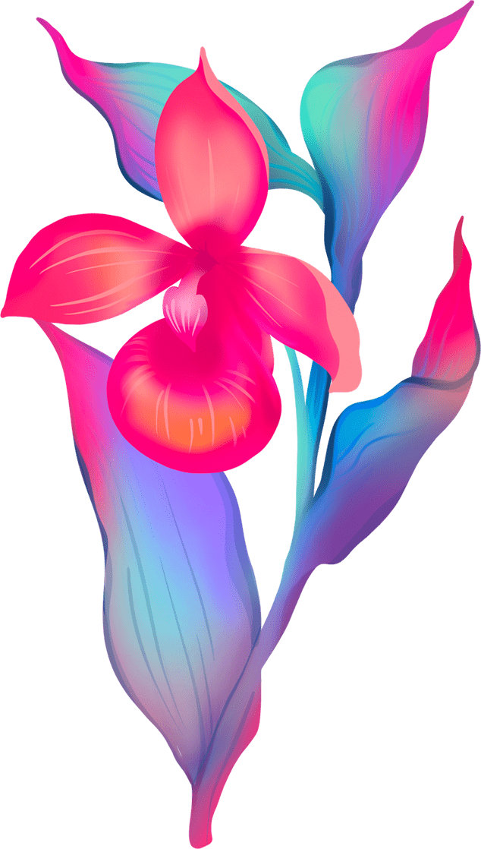


Design Philosophy
Fashion Design is consists of three major things - Imagination, style, creation. It’s a language which create the imagination into reality. Actually fashion design is not about just dress up or drawing figure, it's about love, dream & comfort.

Slide 6
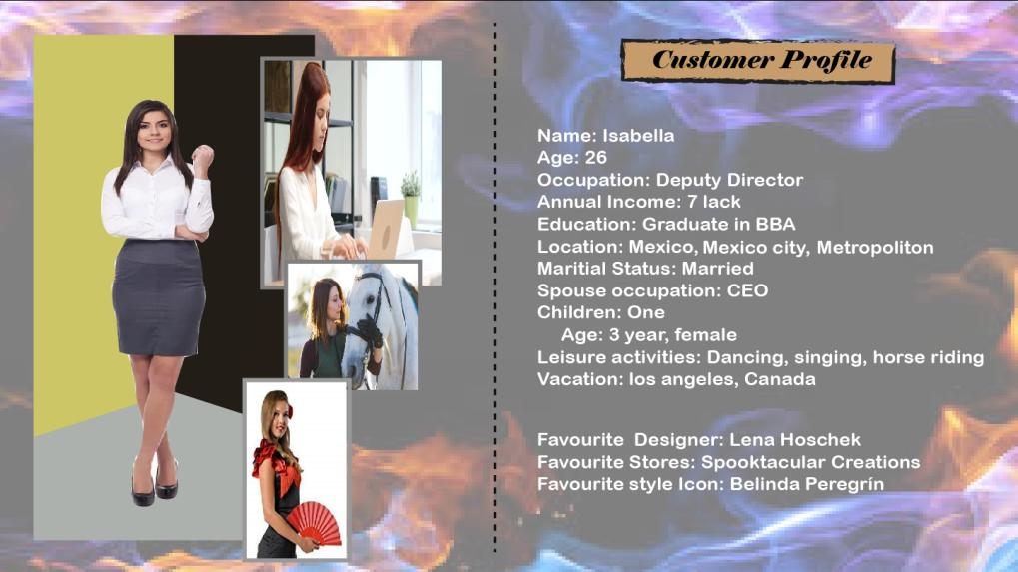

Slide 7
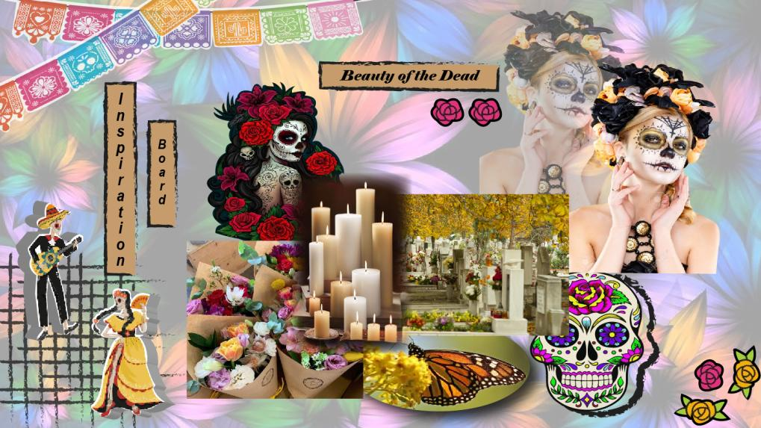

Slide 8
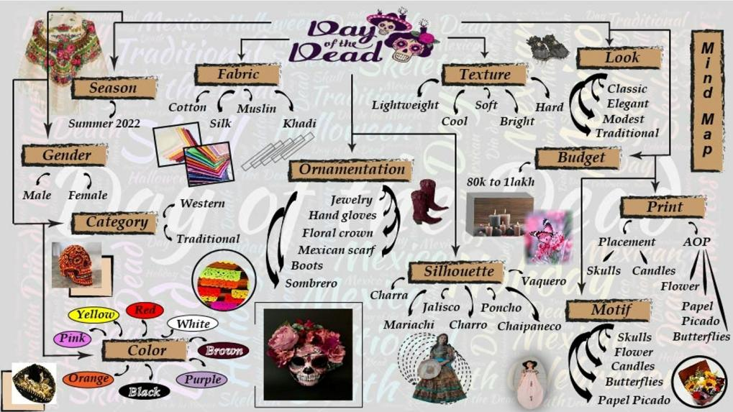

Slide 9
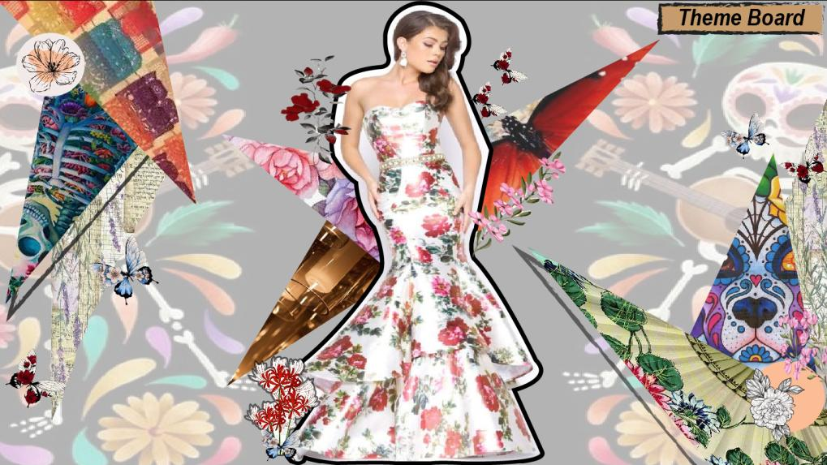

Slide 10



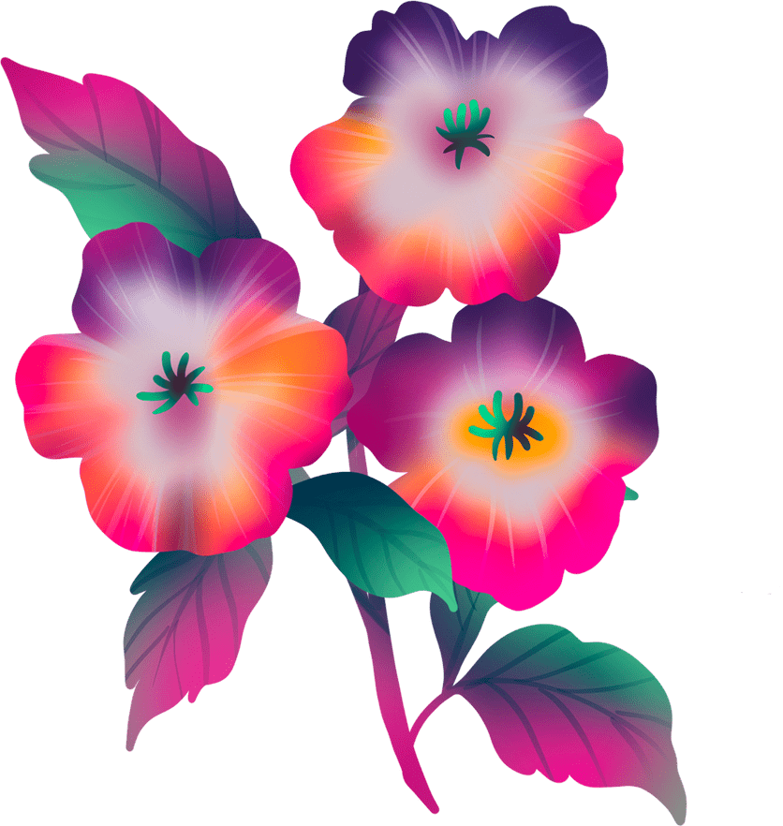

The day of the dead is a long tradition of art depicting skeletons in mexico. It is not like halloween or trick or treating. It has much deeper meaning into it. The skull face paint represent their ancestors who have passed on and celebrates their beauty and necessity of Mexican history.
The day of the dead is the way to celebrates both life & death. Flower, butterflies & skulls are symbols of this day. Flower & dust, love & loss; our lives are filled with both. It has inspired me to understand that the death is necessary but it’s not the end. The bond between family can never end with death.
I can use the symbols as motif, 2d pattern manipulation, print. I can use color as red that represents blood & life, purple that represents mourning & grief, yellow, orrange, pink etc. With this theme ornaments can be made also.
Theme Brief
( The Day of
The Dead )

Slide 11
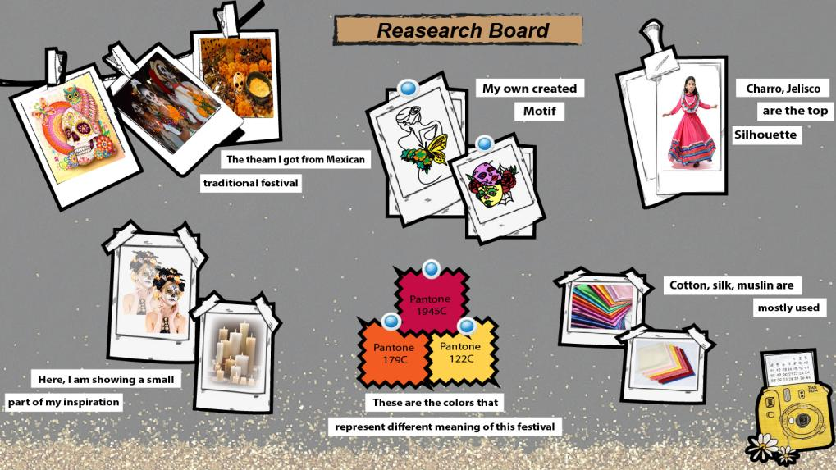

Slide 12
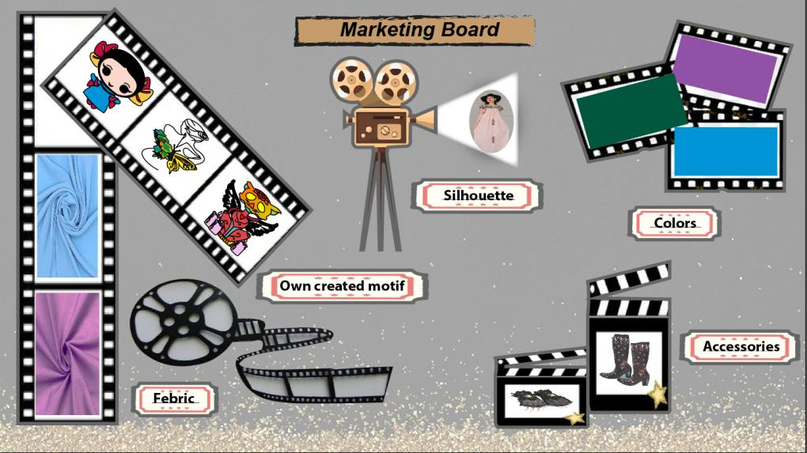

Slide 13
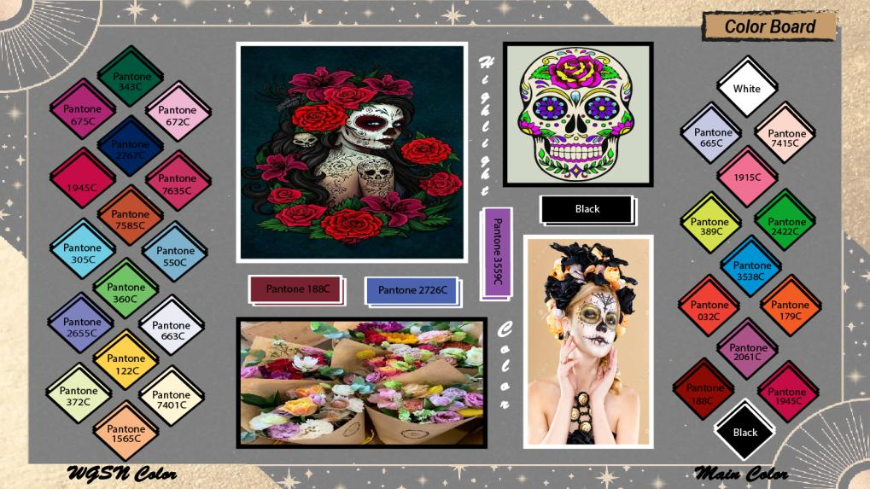

Slide 14
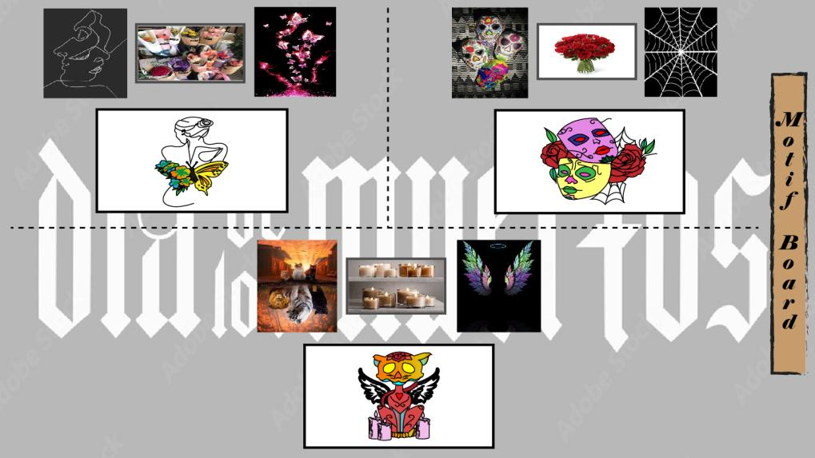

Slide 15
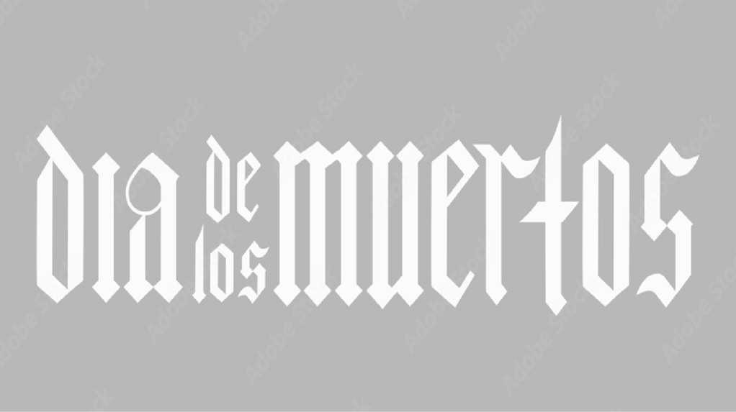


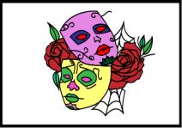
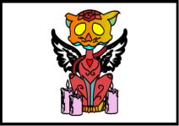
Motif Placement Board
3”
1”
1.5”
5”
1”
1.5”
This motif will be placed the middle of the dress
of style 9
This motif will be placed the middle of the dress
of style 8
This motif will be placed the middle of the dress
of style 5

Slide 16

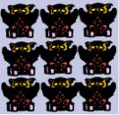
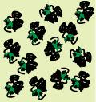
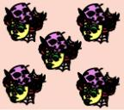
Print Board

Slide 17
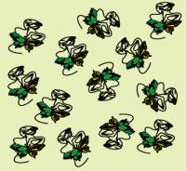
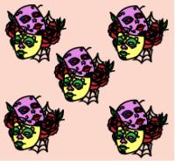
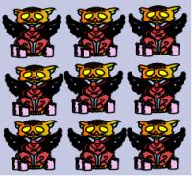
Print Placement Board
This print will be placed the middle of the dress of style 3
This print will be placed the middle of the dress of style 7
This print will be placed the middle of the dress of style 1

Slide 18
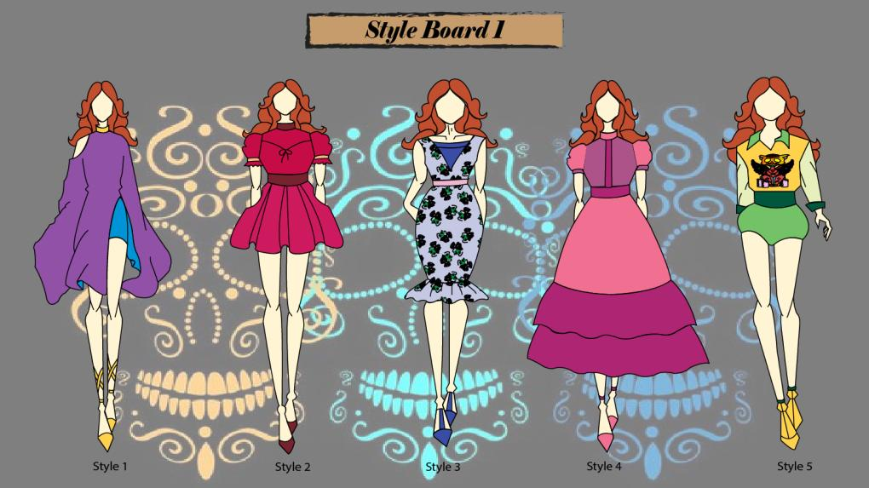

Slide 19
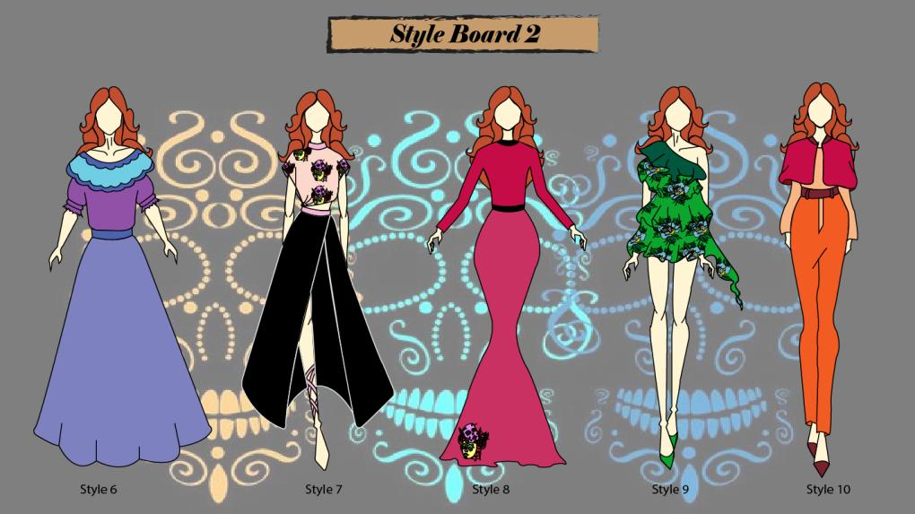

Slide 20
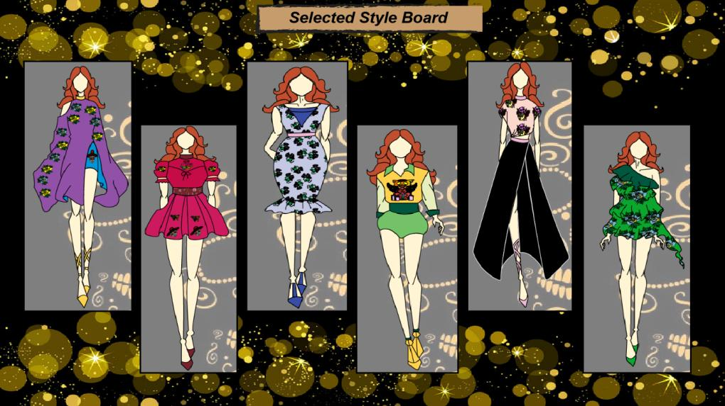

Slide 21
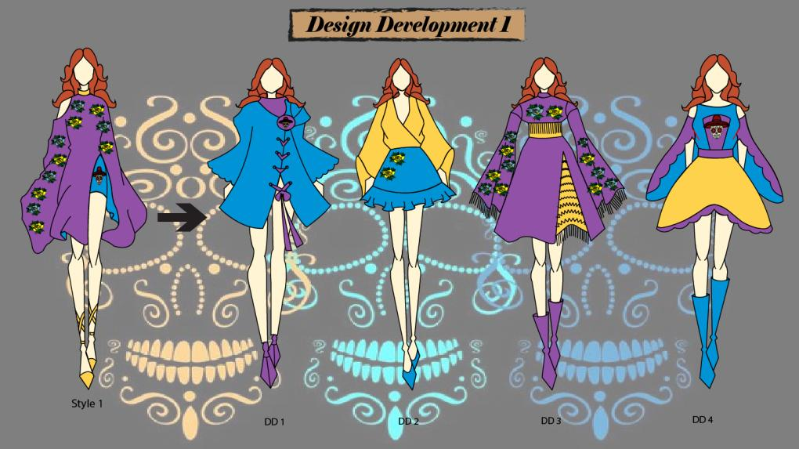

Slide 22
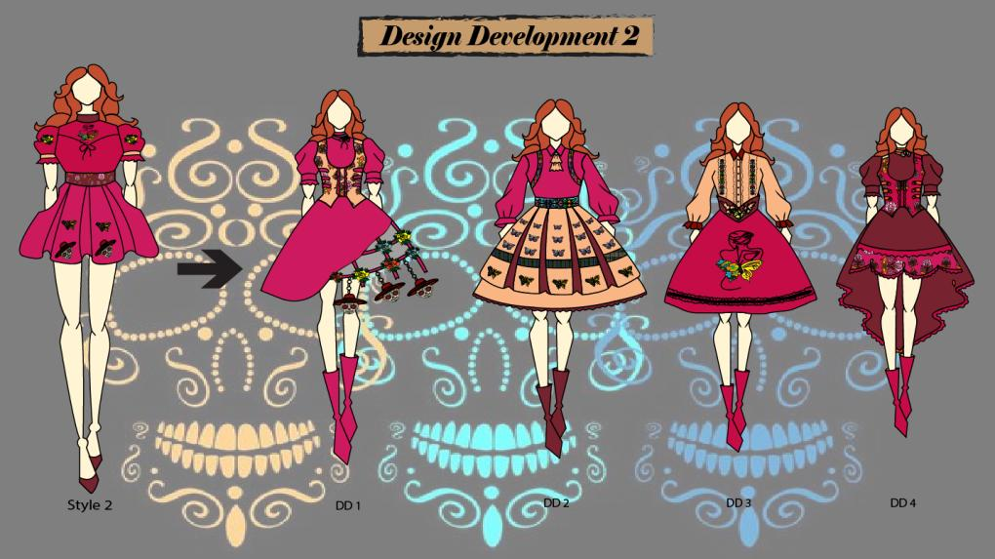

Slide 23
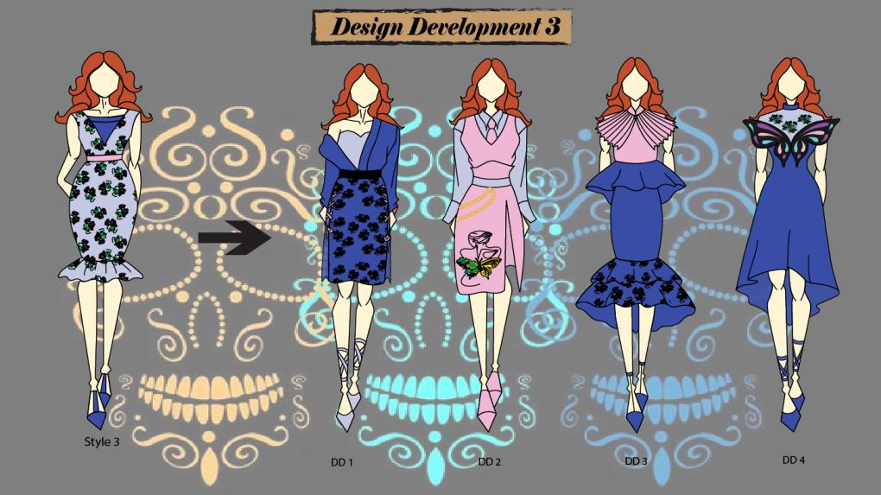

Slide 24
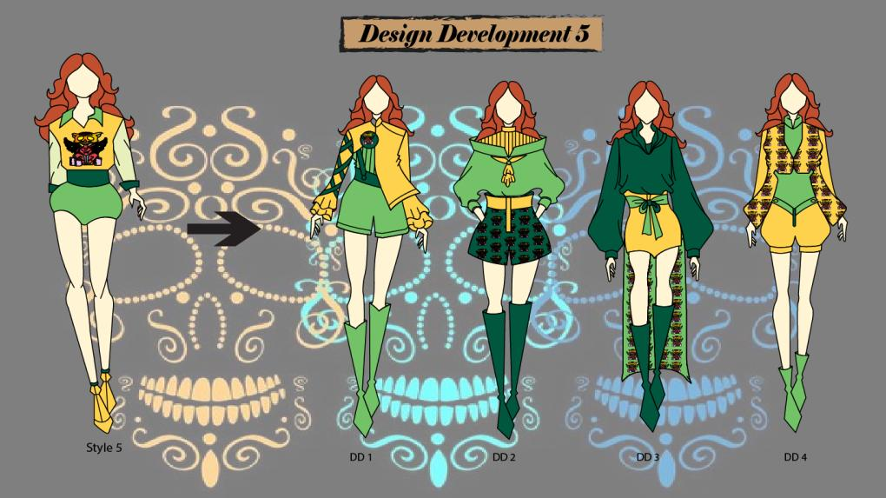

Slide 25
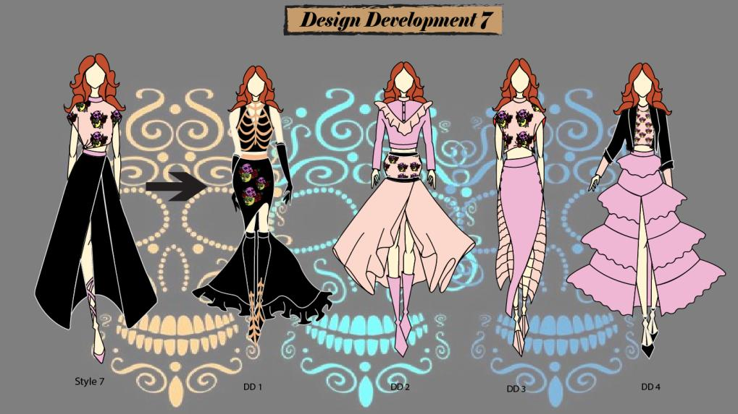

Slide 26
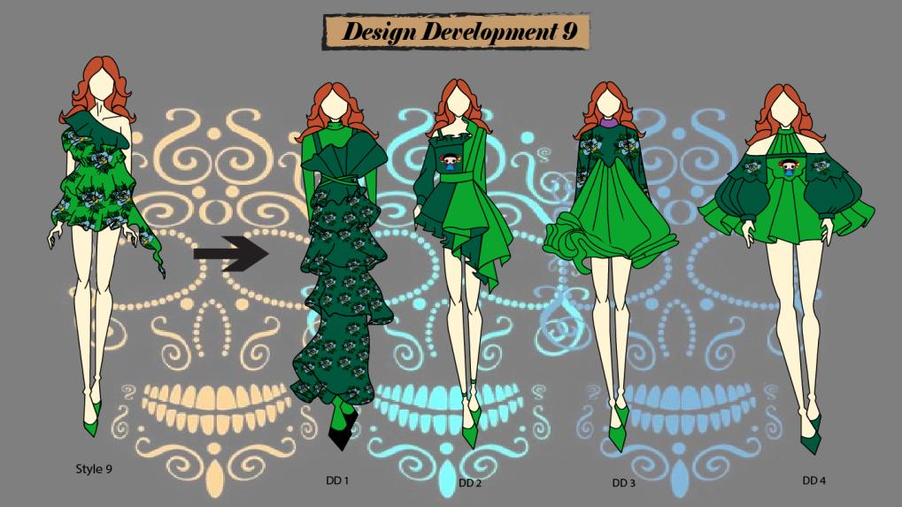

Slide 27
